Slide 1
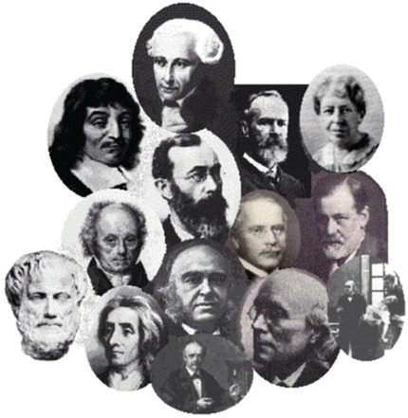
History of Psychology Part 2

Slide 2
History of Psych Timeline
(so far)
Key Events so Far:
  ~400 BC – Greek philosophers
  1879 – Wundt opens the first psych lab; practices Structuralism
    Psychology takes first step towards being science!
  1890 – William James develops Functionalism
  1896 – Sigmund Freud develops psychoanalysis

Slide 3
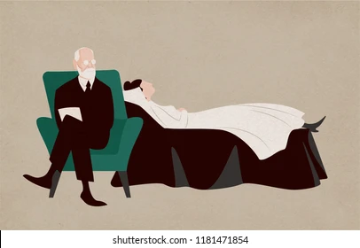
History Recap! (1)
Key points of Psychoanalysis
  Founded by Sigmund Freud
  Psychological disorders == product of our unconscious mind
  Psychological trauma can be healed by recognizing and addressing these issues
  Question it tries to answer: How do our unconscious desires shape who we become?

Slide 4

Why Study Freud? (1)
Freud was wrong about a lot things…
  (More on this when we get to Chapter 11!)
His greatest contribution though…
  Focusing on the unconscious mind without talking about spirits, demons, ghosts, etc.

Slide 5
Why Study Freud? (2)
Some of his ideas weren’t completely off.
Proposed that our experiences as children shape who we become
  Seems reasonable, right?
His “Talking Cure” (talking with patients about their traumas) is the basis for many types of therapy
  Radical idea in the 1890’s!

Slide 6
History Recap! (2)
Key points of Structuralism
  Founded by Wilhelm Wundt
  The mind/consciousness studied through introspection
    Thinking about your mental processes
  Tries to identify the STRUCTURES of consciousness
    Assumes consciousness can be broken down into small parts
  Question it tries to answer: What is consciousness and what is it made of?

Slide 7
History Recap! (3)
Key points of Functionalism
  Founded by William James
  Tries to identify the FUNCTION of the mind/consciousness
    Assumes the mind exists for a reason
    Mental states and behavior are survival mechanisms
  Question it tries to answer: Why do we have conscious experiences?

Slide 8
Structuralism vs. Functionalism
 | Structuralism | Functionalism
Founder | Wundt | James

Slide 9
Structuralism vs. Functionalism
 | Structuralism | Functionalism
Founder | Wundt | James
Key question(s)? | What is consciousness? | Why do we have consciousness?

Slide 10
Structuralism vs. Functionalism
 | Structuralism | Functionalism
Founder | Wundt | James
Key question(s)? | What is consciousness? What happens when someone does something? | Why do we have consciousness? Why doe people act certain ways?

Slide 11
Structuralism vs. Functionalism
 | Structuralism | Functionalism
Founder | Wundt | James
Key question(s)? | What is consciousness? What happens when someone does something? | Why do we have consciousness? Why doe people act certain ways?
Part or whole? | Parts! Wants to break consciousness into pieces! | Whole! Consciousness can’t be split apart!

Slide 12
Structuralism and Functionalism Today
Both Functionalism and Structuralism died out in the early 1900’s
Functionalist and Structuralist psychologists don’t exist anymore!
Why do psychologists today even care?
Paved the way for other approaches to psychology
Example: Functionalism → Behaviorism

Slide 13
Timeline of Functionalism and its Offshoots
Functionalism
Died out early 1900’s
Behaviorism
Fell out favor 1950’s
Evolutionary Psych
Currently a popular approach

Slide 14
Psychology and Behavior
Early “psychologists” were interested in questions about the mind
  Can we measure consciousness, unconsciousness, etc. (Example: Wundt/James vs. Freud)
  Is the mind separate from the body?
What about behavior?
  Much easier to study since we can observe it!
  Can behavior act as proxy for the mind?
This led to behaviorism, which was the dominant school of thought for the early 1900’s

Slide 15
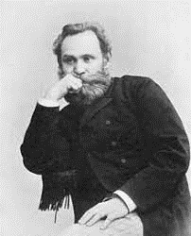
Ivan Pavlov (1849 – 1936)
Russian physiologist (NOT A PSYCHOLOGIST)
Studied digestive systems of dogs
Noticed that dogs will salivate naturally when presented with food
  Natural response to a natural stimulus!
  Dogs encounter food in their environment!

Slide 16
Ivan Pavlov (1849 – 1936)
Russian physiologist (NOT A PSYCHOLOGIST)
Studied digestive systems of dogs
Also noticed that dogs salivated at the sight of his assistant’s white lab coat
  Pavlov’s assistant would feed the dogs; dogs learned to ASSOCIATE the white coat with mealtime
  Not a natural response!

Slide 17
Pavlov and Conditioning
Pavlov set up an experiment to investigate this finding
Rung a bell at feeding time
After enough time, Pavlov’s dogs would salivate anytime they heard the bell
  Didn’t matter if there was food present!
Termed “Classical Conditioning”

Slide 18
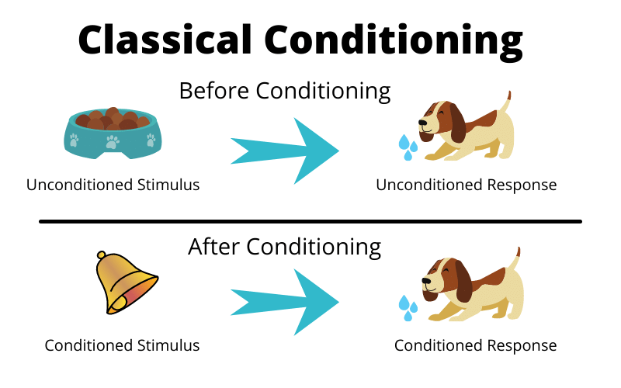
Classical Conditioning

Slide 19
Classical Conditioning

Slide 20
Pavlov’s Contribution to Psychology?
Pavlov’s findings greatly influenced psychologists!
Planted the seeds for behaviorism
  Emphasized observable behavior
Later researchers interested in whether conditioning could be used to discover “laws of learning”

Slide 21
Reminders about Behaviorism
Behaviorism rejected any reference to the mind
Viewed observable behavior as the proper subject matter of psychology
Since the mind cannot be observed, it is not worth studying
Hoped that the scientific study of learning could reveal laws that would promote the prediction and control of behavior

Slide 22
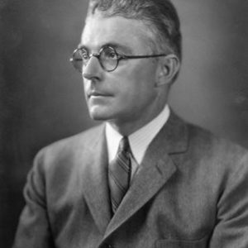
John B. Watson (1878 – 1958)
Popularized behaviorism in the early 20th century
Primarily focused on animal research and child rearing
Used lots of children in his research
  Little Albert Experiment
  Little Peter Experiment

Slide 23
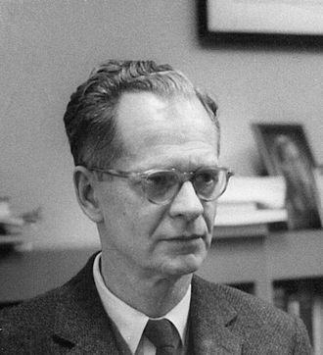
B. F. Skinner (1904-1990)
Never intended to be a psychologist
  Was an English major in college
  Aspired to be a writer
Encountered Watson’s behaviorism after college
  This was his gateway to psych!
  Became one of the most prominent psychologists of the 20th century

Slide 24
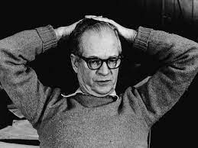
Behaviorism and B. F. Skinner
“Give me a child and I can shape him into anything”
  Who does that sound like???
Skinner pioneered operant conditioning
  Operant Conditioning == Shaping behavior through rewards and punishments

Slide 25
Operant Conditioning
Relies on punishments and reinforcements
Reinforcement encourages or motivates a specific behavior
  Something desired (Rewards, food, etc.)
Punishment discourages behavior
  Painful or unpleasant
Do you think one is more effective than the other?

Slide 26
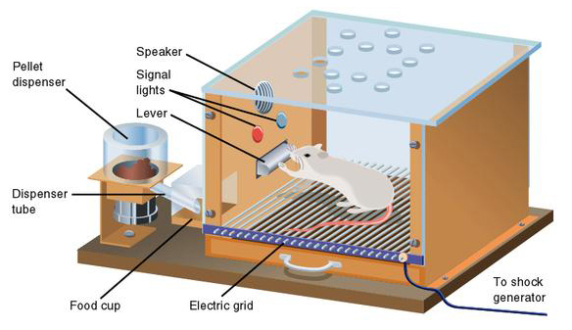

Slide 27
B. F. Skinner
Operant conditioning chambers were useful for studying learning, memory, and schedules of reinforcement
But Skinner had some other interesting ideas
  Pigeon guided bombs
  The air crib

Slide 28
The Rise of Humanism
American Psychology in the early 20th century was dominated by behaviorism and psychoanalysis
Some psychologists rejected the pessimistic nature of psychoanalysis
Others disliked the deterministic nature of behaviorism (all behavior is determined by genes and environment)

Slide 29
The Rise of Humanism
The Humanistic Approach emerged as a response to behaviorism and psychoanalysis
Emphasized personal control and the good in people as important parts of our self-concept and behavior
Current research in this area focuses on happiness, self-concept, and meditation
Key tenet of humanism is that all people have the potential for good

Slide 30
The Rise of Humanism
Often referred to as “the third force” in psychology
Emphasized conscious experience rather than the subconscious (Freud) or the environment (Watson and Skinner)

Slide 31
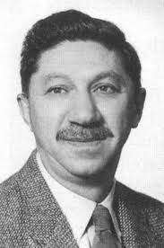
Abraham Maslow (1908-1970)
Maslow was an early pioneer of the humanistic approach
Best known for his hierarchy of needs
As long as basic needs are met (e.g., food and shelter), individuals would be motivated to pursue higher-level needs (e.g., social behaviors)

Slide 32
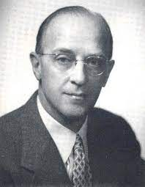
Carl Rogers (1902 – 1987)
Used the humanistic approach to develop a client-centered therapy method
Emphasized the potential for good that exists in all people
Believed that people were more than capable of dealing with and working through their own issues

Slide 33
Client-Centered Therapy vs. Psychoanalysis (1)
Psychoanalysis: The therapist interprets what conscious behaviors reveal about the unconscious mind
Client-centered approach: The patient takes the lead role. The therapist provides unconditional positive regard
  Unconditional Positive Regard: Therapist accepts the client for who they are, regardless of what the client may say or do

Slide 34
Client-Centered Therapy (CCT) vs. Psychoanalysis (2)
 | Rogers (CCT) | Freud (Psychoanalysis)
Human nature? | People can be good or bad | People are inherently bad
Role of the therapist? | Facilitate patient’s self-discover | Provide interpretation
Presentation of the therapist? | Someone who cares, is willing to listen | An authority figure, a teacher who explains what your symptoms mean

Slide 35
Client-Centered Therapy (CCT) vs. Psychoanalysis (2)
 | Rogers (CCT) | Freud (Psychoanalysis)
Human nature? | People can be good or bad | People are inherently bad
Role of the therapist? | Facilitate patient’s self-discover | Provide interpretation
Presentation of the therapist? | Someone who cares, is willing to listen | An authority figure, a teacher who explains what your symptoms mean

Slide 36
Client-Centered Therapy (CCT) vs. Psychoanalysis (2)
 | Rogers (CCT) | Freud (Psychoanalysis)
Human nature? | People can be good or bad | People are inherently bad
Role of the therapist? | Facilitate patient’s self-discover | Provide interpretation
Presentation of the therapist? | Someone who cares, is willing to listen | An authority figure, a teacher who explains what your symptoms mean

Slide 37
The Cognitive Revolution
By the 1950’s, new disciplines were emerging in Linguistics, neuroscience, and computer science
These areas of study revived interest in the scientific study of the mind rather than observation of behavior
This shift is referred to as the cognitive revolution

Slide 38
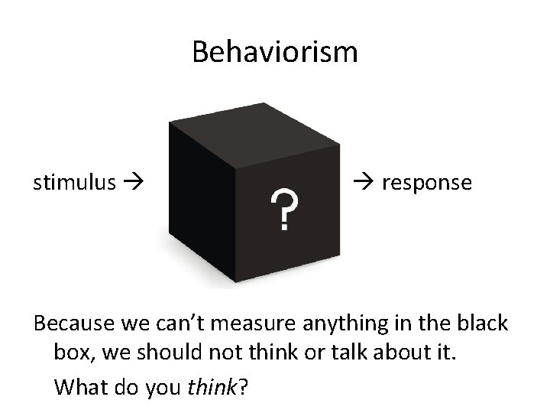

Slide 39
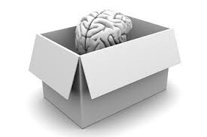
Cognitive Psychologists try to open the black box

Slide 40
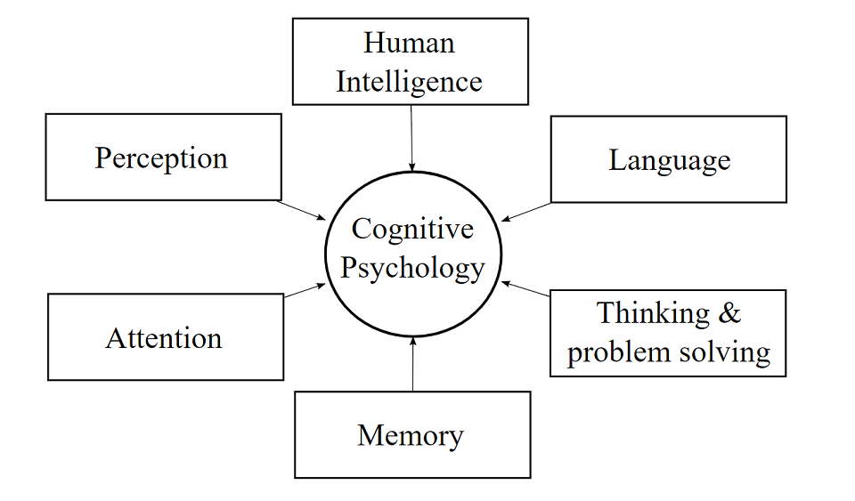
So what’s in the box?

Slide 41
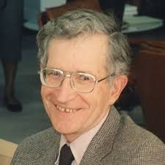
Noam Chomsky (1928 - )
Chomsky was influential in the cognitive revolution
Believed that psychology’s focus on behavior was short-sighted
Behavior cannot truly be understood without also understanding the cognition driving it.

Slide 42
Applied Psychology
Applied Psychology == the application of psychology to everyday life
  Example: Intelligence Testing, Therapy, Treatment of psychological disorders
Applied research looks for solutions to practical problems!

Slide 43
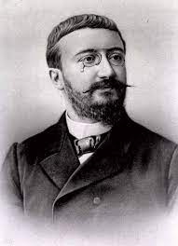
Intelligence Testing
Early applied psychology focused on Intelligence Testing
Alfred Binet (1857-1911)
  His test was later standardized and became the basis for modern IQ testing

Slide 44
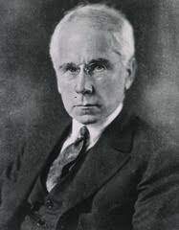
Rise of Clinical Psychology
Lightner Witmer (1867 – 1956)
  Considered the father of Clinical Psychology
  Student of Wilhelm Wundt (Structuralism)
  Believed that because psychology dealt with the study of sensation/perception, it could treat children with learning/behavioral problems

Slide 45
Clinical Psychology and World War II
The psychiatric casualties of the war were staggering
  Not enough mental health professionals to meet the need
National Mental Health Act of 1946 provided funding to develop training programs that would produce clinical psychologists
Led to a scientist-practitioner model of training

Slide 46
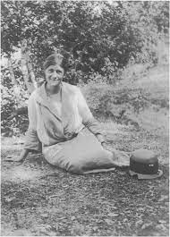
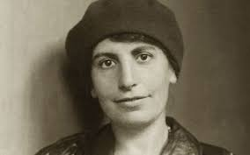
Psychology and Society
Because psychologists deal with the human conditions, they are often involved in social issues
Helen Thompson Woolley (1874 – 1947) and Leta S. Hollingsworth (1886 – 1939) pioneered the psychological study of sex differences

Slide 47
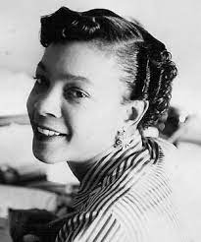
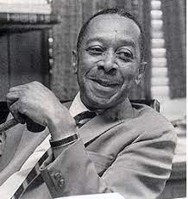
Psychology and Society
Mamie Phipps Clark (1917 – 1983) and Kenneth B. Clark (1914 – 2005) studied the psychology of race and the negative effects of school segregation on African-American children

Slide 48
Current Trends and Future Directions
Neuroscience (study of the brain/nervous system)
Cognitive psychology (study of mental processes)
Social psychology (study of human interactions)
Evolutionary psychology (study of adaptive value of behavior)

